Slide 1
A SUBSTITUTE TEACHER'S 8-WEEK MEASUREMENT CYCLE
Did focused practice
improve classroom
management?
+134%
overall confidence growth
from 2.0 to 4.7 on a 5-point scale
PDP Measurement & Evaluation · Apr 13 to Jun 5, 2026

Slide 2
STEP 1
Define the question
Substitute teaching tests classroom management.
You enter a new room, grade, and student group most days.
THE GUIDING QUESTION
Did focused use of social-emotional language,
positive behavior supports, routines, transition steps,
and prep improve classroom management?
Social-emotional language means naming feelings and reset choices. Positive behavior supports means praise, reminders, and clear expectations.

Slide 3
STEP 2
The study at a glance
40
3
13
10
school days
observed
phases:
Baseline to Strategy to Mastery
classrooms
visited 3 to 4 times each
rated measures
per day
Baseline measured starting habits. Strategy added named techniques.
Mastery refined which technique fit each classroom moment.

Slide 4
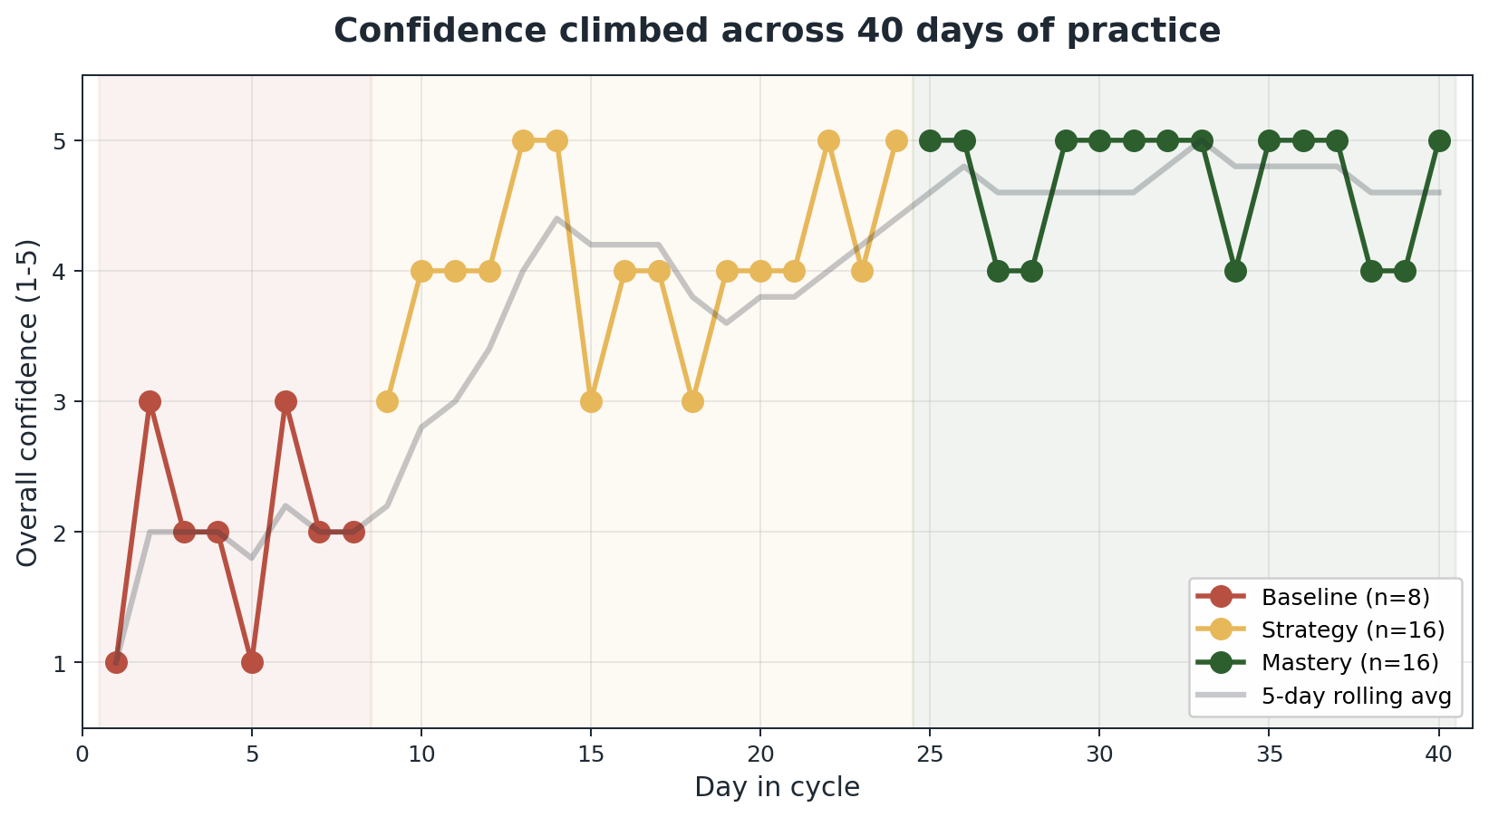
THE PATTERN
Confidence rose in steps.
BASELINE
avg 2.0
starting point
STRATEGY
avg 4.1
named strategies
MASTERY
avg 4.7
refined use
The largest gain followed the start of named strategies. Mastery added another +0.6 points.

Slide 5
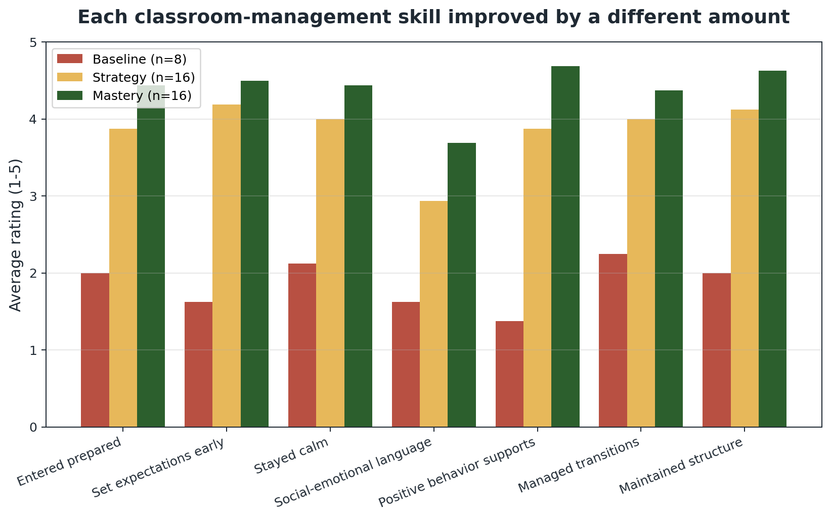
WHERE THE GROWTH HAPPENED
Behavior supports led. Emotional language trailed.
BIGGEST GAIN
Positive behavior supports
1.38 to 4.69
+241% growth
NEXT TARGET
Social-emotional language
1.62 to 3.69
still below the 4.0 target
Praise, expectations, and reminders moved fastest. Feelings and reset language need more planned practice.

Slide 6
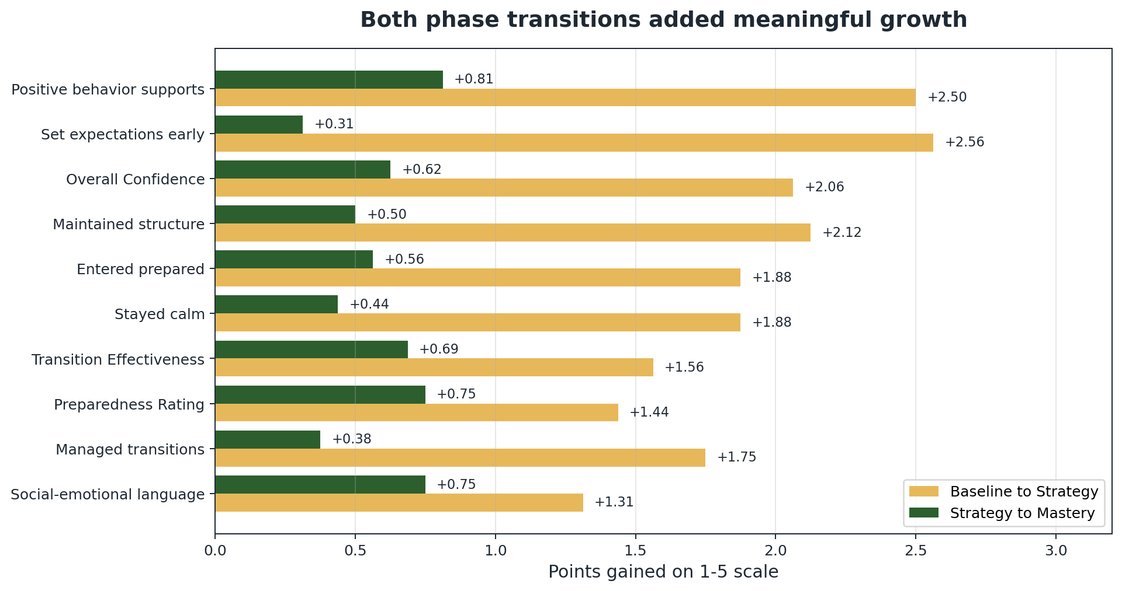
ADDED GROWTH
Both phase changes improved the score.
Baseline to Strategy
added +2.1 points,
from 2.0 to 4.1.
Strategy to Mastery
added +0.6 points,
from 4.1 to 4.7.
Stopping after Strategy
would miss the last
+0.6 points.
Keep the Mastery phase because refinement produced measurable added gain.

Slide 7
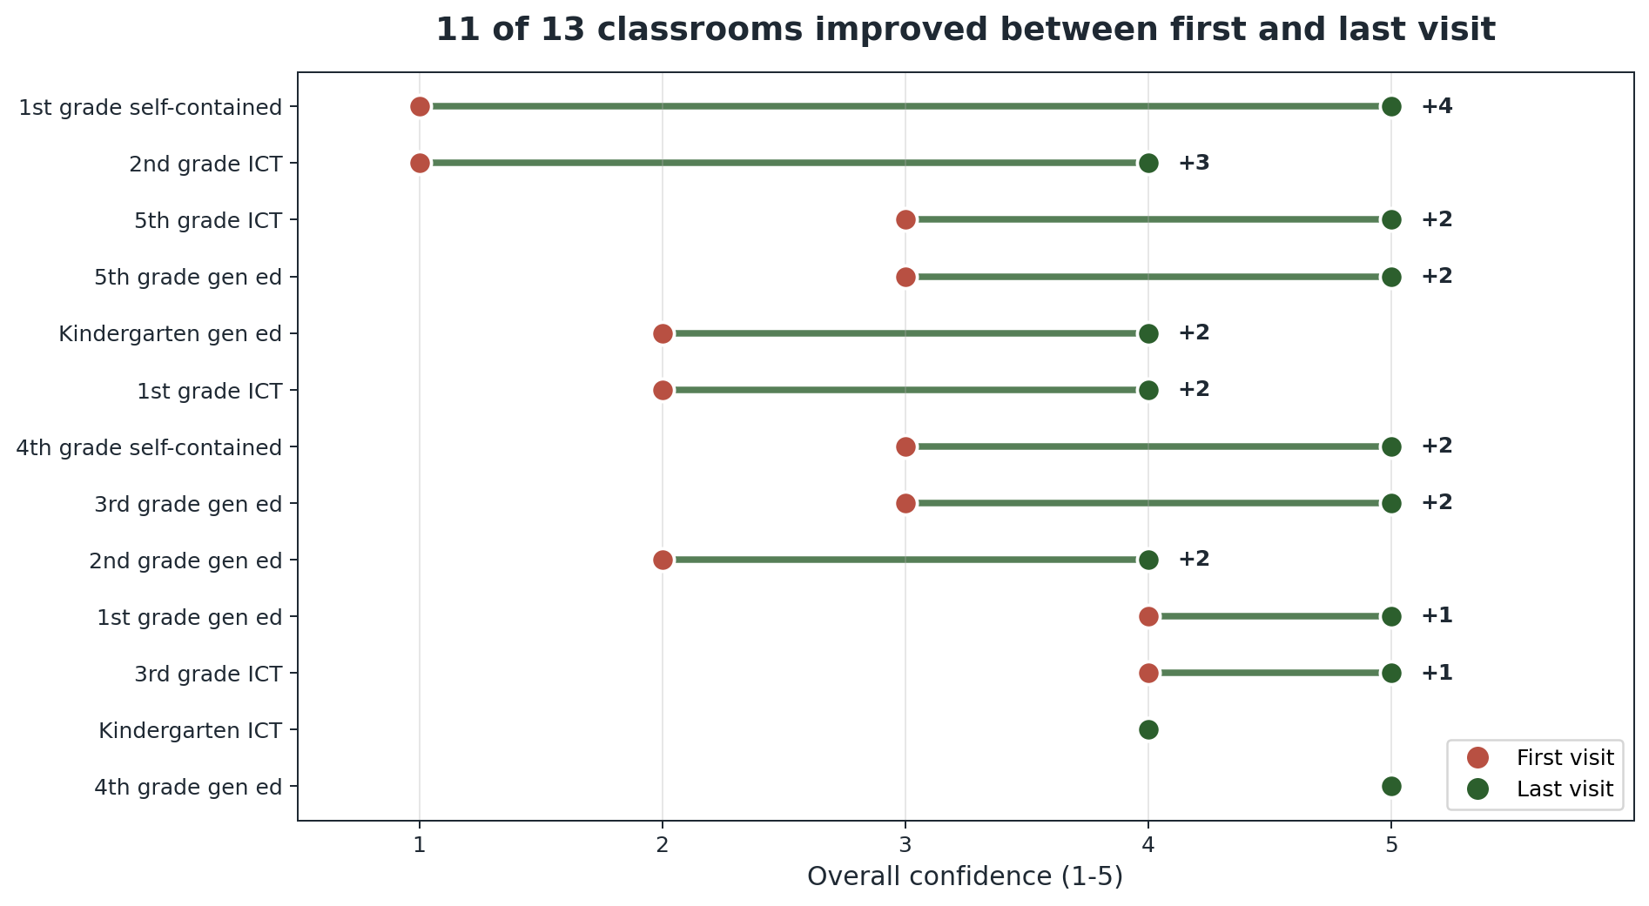
THE CONFOUND CHECK
Same room. Better outcome.
WHY THIS MATTERS
If easier rooms came later, repeat visits would not rise inside the same rooms.
11 of 13 classrooms scored higher on the last visit than the first.
Mean within-room gain: +1.77 points.
Room difficulty does not explain the full increase.

Slide 8
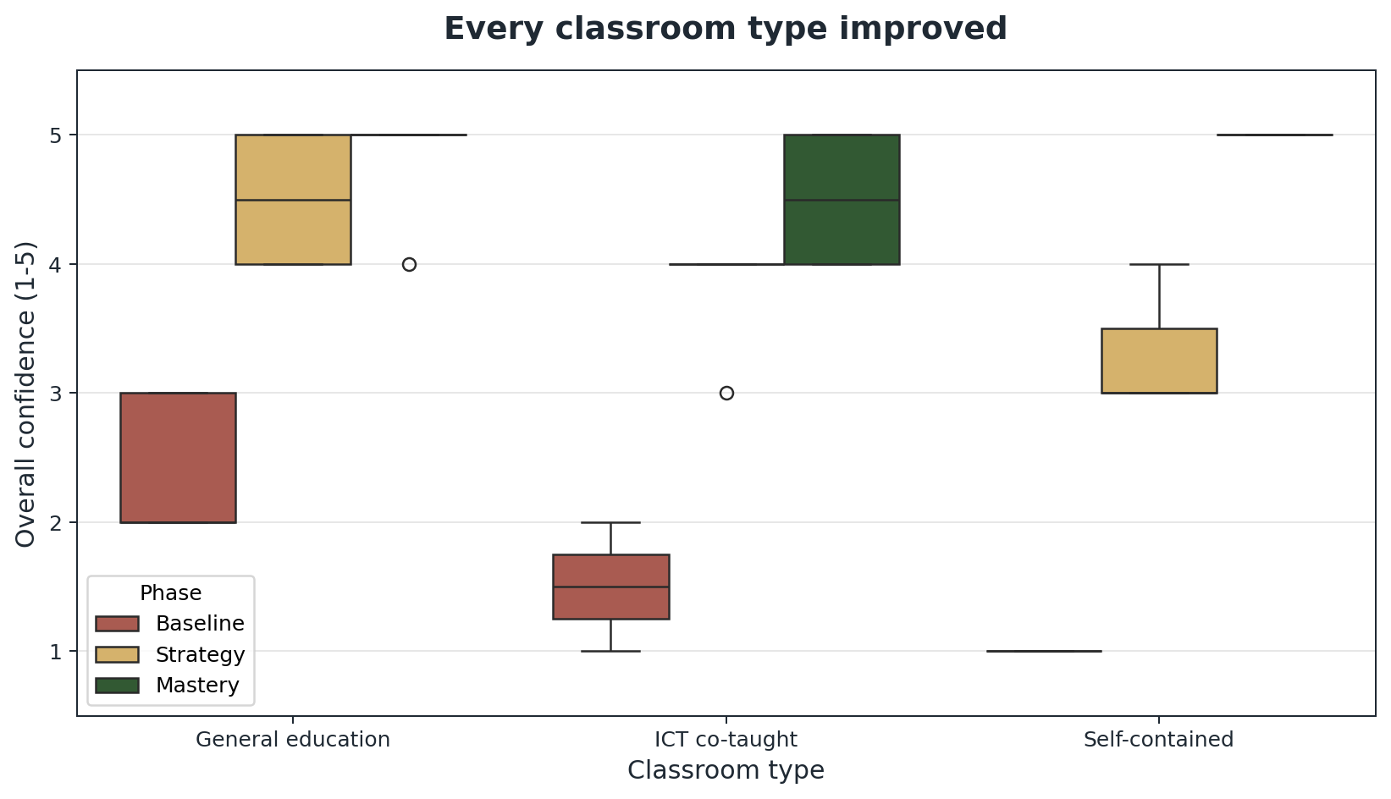
CLASSROOM TYPE CHECK
Specialized settings improved too.
General education
rooms averaged 4.83
in Mastery.
ICT co-taught rooms
averaged 4.50.
Self-contained rooms,
smaller specialized classes,
averaged 5.00.
Higher-need settings started lower, then gained the most after routines became consistent.

Slide 9
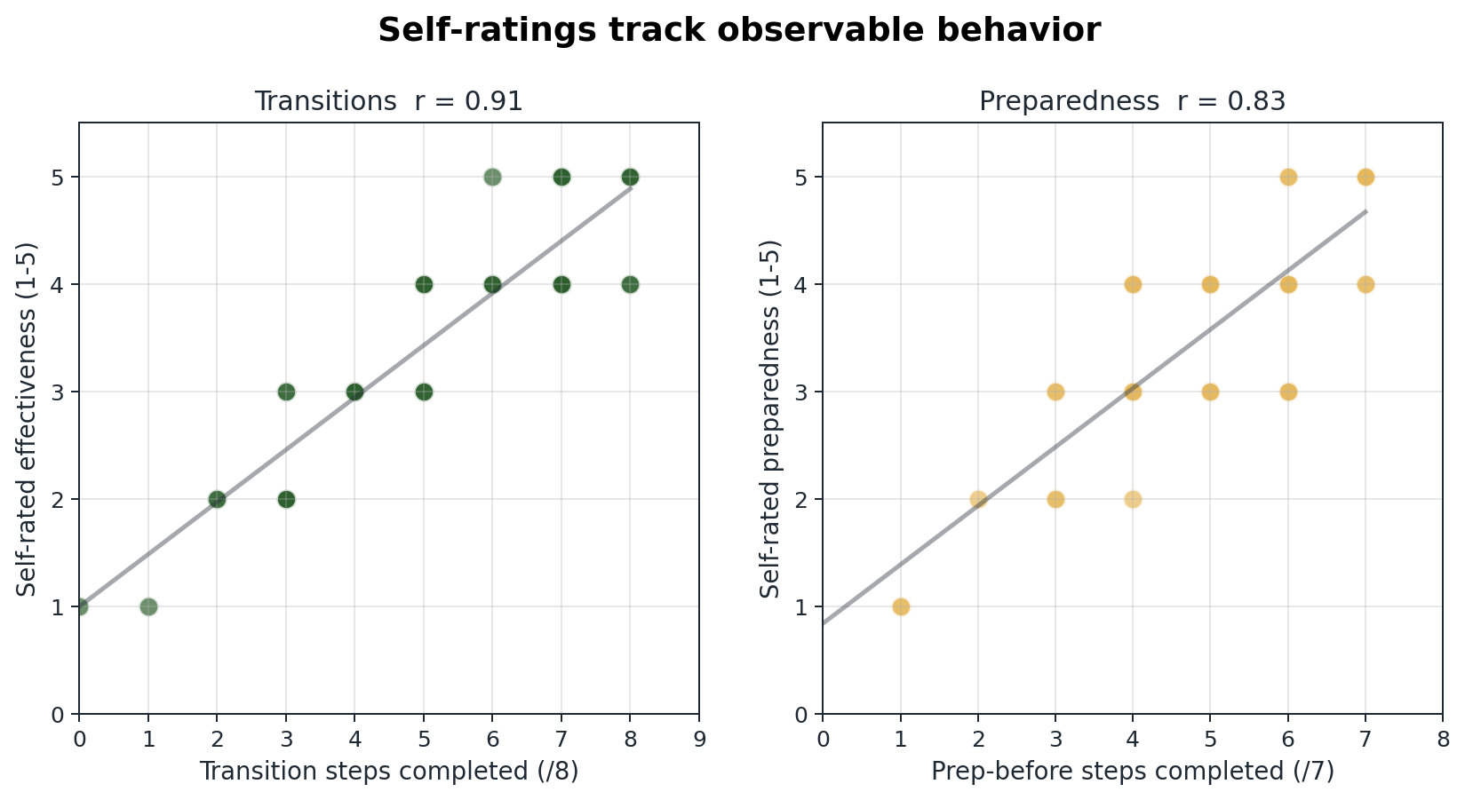
RATING CHECK
Counts support the self-ratings.
Transition checklist completion tracked transition ratings at r = 0.91.
Prep checklist completion tracked preparedness ratings at r = 0.83.

Slide 10
STEP 7 · COMMUNICATE
Next cycle actions.
1
Practice social-emotional language first
Score rose from 1.62 to 3.69. Target remains 4.0. Plan 2 reset phrases before each lesson.
2
Lean into repeat visits
Same-room growth gave the clearest signal, +1.77 points. Build a 5 to 6 room rotation.
3
Test strategy days inside each phase
Alternate strategy and comparison days in the same phase. Separate practice from calendar time.

Slide 11
THE TAKEAWAY
Practice improved
the score.
Overall confidence rose from 2.0 to 4.7.
Positive behavior supports rose from 1.38 to 4.69.
Social-emotional language reached 3.69, so start there next.
Next: plan, rehearse, and measure reset language.

